Slide 1
KKJT > ∞
Sudoku Solver & Generator
Kathleen Near
Tanya Olivas
Jared Peterson
Kurtlynd McLane

Slide 2
Sudoku Solver & Generator
Generates a Sudoku puzzle to be solved
Puzzle follows standard rules – numbers one to nine in every row, column, and section without duplicating
Option to solve puzzle for current puzzle or custom made
Option to increase or decrease difficulty (easy, medium, hard)
Option to shrink from standard 9x9 puzzle to 4x4 puzzle

Slide 3
Deciding Architecture
Basic program with no communication between clients
Heavily based on user input to produce final product
Graphical user interface provides easy accessibility
Program algorithm filters numerous amounts of input

Slide 4
Design Choices
Pipes-and-Filter
Input from user processed by algorithm for comparison against answers and then feedback
Layering
Program designed in levels where GUI module accesses main algorithm and other modules

Slide 5
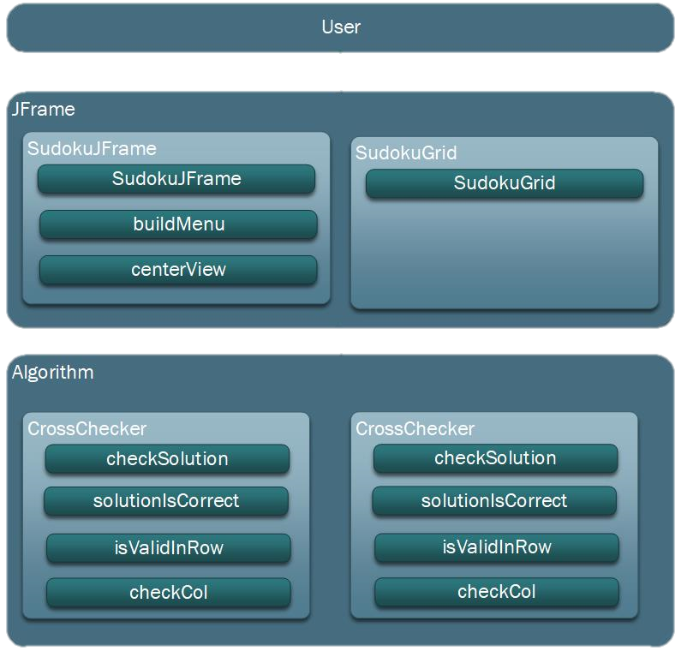
Decision to Use Layering
Our program naturally utilizes a layered structure; modules neighbor each other and use each others’ services.
Layering allows for our program’s modules to communicate effectively, back and fourth.
This style allows us to easily make more modifications – something necessary due to the need for low dependency between our modules.

Slide 6
Summary
Our Sudoku Solver & Generator generates and solves custom and pre-made puzzles with many options to improve the gaming experience.
Driving factors to consider for architectural design included a GUI interacting with an algorithm and frequent input provided by the user
Pipe-and-Filter and Layering were the two styles we considered.
Our program naturally works with Layering in addition to the styles’ own practicality for this project

